Slide 1

Unveiling the path to Spring Boot 3 at the most important tech company you've never heard of
Laurentiu Marinescu
Senior Software Engineer

Slide 2
Goals for this talk
What is ASML?
Is Java contributing to chips high-volume manufacturing?
How to handle distributed tracing?
Spring Boot 3 migration: challenges and solutions

Slide 3
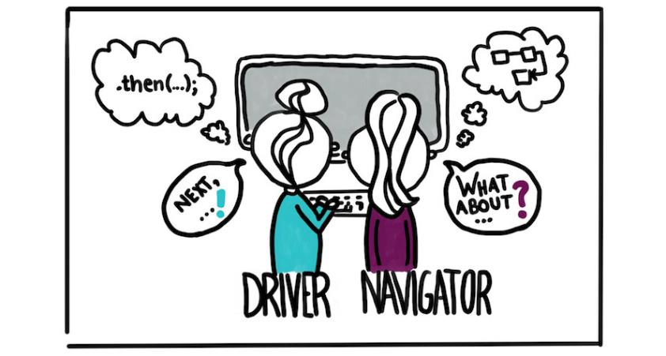

Laurentiu Marinescu
Senior software engineer @ ASML
Full stack sw engineer, problem solver
Building next generation cloud platform @ ASML.
Passionate about software craftsmanship, new tech and being a people's person.
Advocate of pair/team programming.
Bouldering/Climbing lover
Source: Martin Fowler
"email" : "laurentiu.marinescu@asml.com", "linkedin" : "https://nl.linkedin.com/in/laur-marinescu", "x" : "@laurrmarinescu"

Slide 4



A global presence with >42,000 employees (year-end 2023)
And offices in more than 60 locations worldwide
Belgium
France
Germany
Ireland
Israel
Italy
The Netherlands
United Kingdom
China
Japan
Malaysia
Singapore
South Korea
Taiwan
United States
Europe
Asia
8,500
24,000
9,500
4

Slide 5
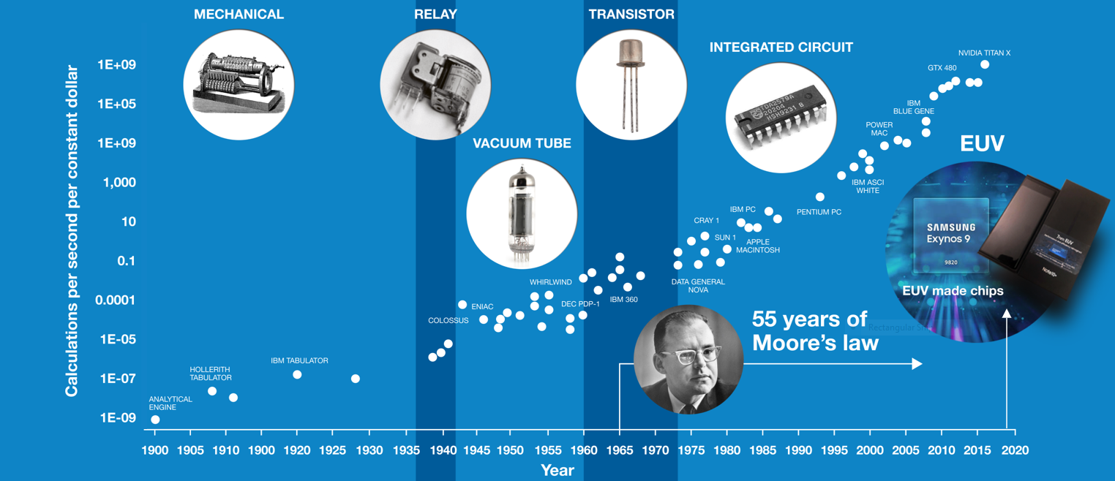
The world has been improving computing power for 120 years
Source: Ray Kurzweil, Steve Jurvetson
5

Slide 6

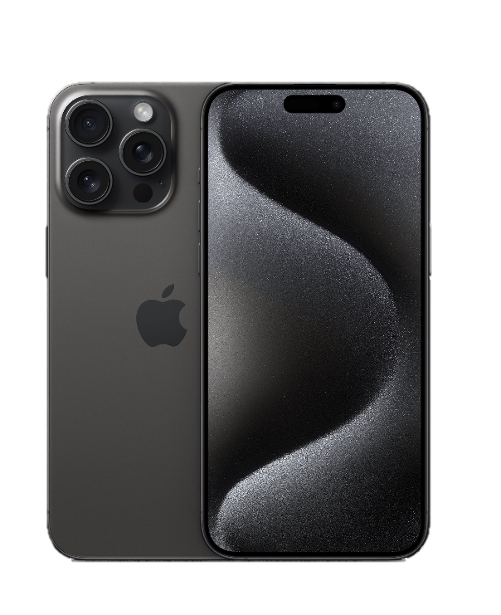
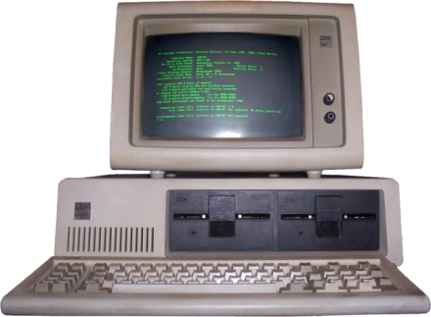
…and electronic devices much more powerful
IBM
5150
1984
2023
Apple iPhone 15 Pro Max
year manufactured
$1500–$3000 $3500-$7000 today
$1199–$1599
price
16-bit Intel 8088 4.77 MHz
Apple A17 Pro chip (3 nm EUV)
processor
16–265 kB
8 GB
working memory
5″ floppy disk 160 kB
up to 1 TB
internal storage
640x200 pixels
2796 x 1290 pixels
display
29,000
19 billion
transistor count
12.7 kilogram
221 grams
weight
6

Slide 7
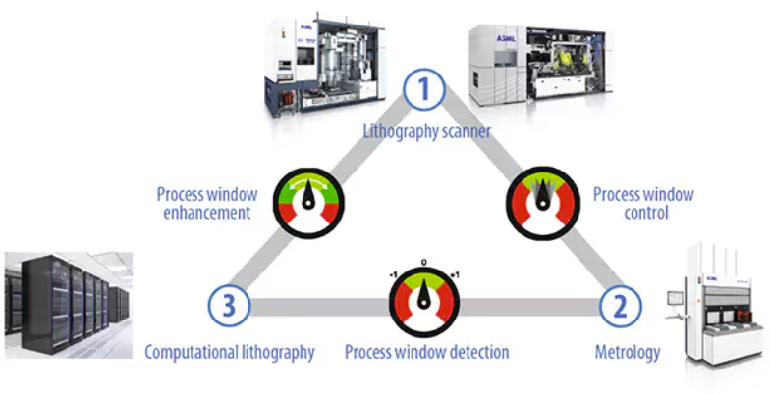
Yield
Throughput
7

Slide 8
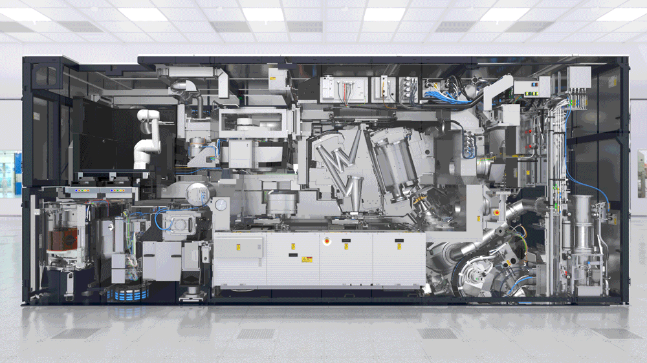
8

Slide 9

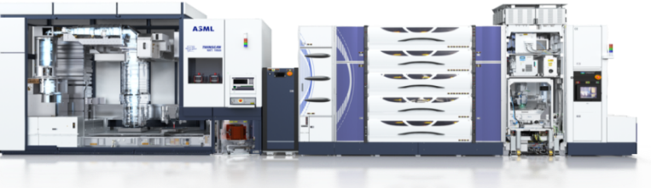


High volume manufacturing
Scanner
Litho Metro
SW Applications / Processes
9

Slide 10

Fully air gapped platform

Slide 11

Rolling upgrades in a closed environment

Slide 12

What is our platform?
Highly scalable
Highly available
Zero downtime
Secure
Monitoring
For large volumes of data
For computing intensive applications
Based on Open (and de-facto) standards

Slide 13








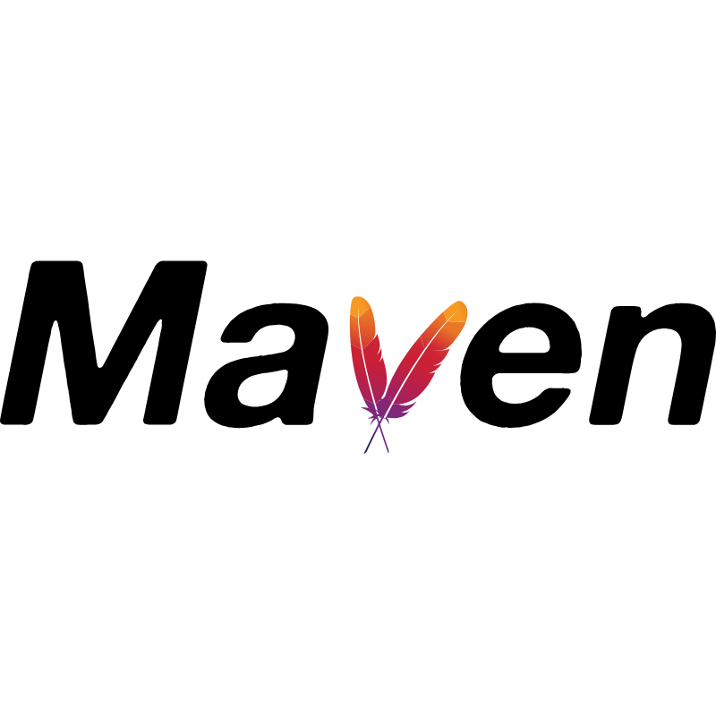






























Technologies

Slide 14

14

Slide 15

Migration Journey
Step upgrades – Rinse and repeat
Java 8 + Spring Boot 2.2
Java 17
Spring Boot 3.0
Java 21 + Spring Boot 3.2
Baseline.
Intermediate steps:
Spring Boot 2.3
2.4
2.5
2.6
Java 8 + Spring Boot 2.7
Intermediate step: Java 11
Performance improvement
Default garbage collector G1
Container awareness
First solution with Spring Boot 3
Faster start up time
AOT
Observability
Intermediate steps: Spring boot 3.1
Improved performance
Virtual threads
CRaC
15

Slide 16

Migration Challenges

Slide 17

Distributed tracing

Slide 18
Spring boot 2.x - Spring cloud sleuth
Spring cloud sleuth is the tracing layer over Brave (openzipkin standard) tracing library.
The default observability format is B3.
18

Slide 19
Spring boot 3.x - Micrometer tracing
Spring Cloud Sleuth is no longer supported by Spring Boot v3, see official migration guide.
Replaced with Micrometer Tracing.
Facade tracer library over the Brave and OpenTelemetry tracers.
The default propagation format for OTEL is W3C.
19

Slide 20
Micrometer tracing
Joined spans no longer supported.
Multiple context propagation types were not supported.
The logging pattern that contains trace and span IDs is no longer autoconfigured.
Executor and executor service instrumentations (e.g. `LazyTraceExecutor`) that would propagate the tracing context together with a creation of a span are no longer available.
20

Slide 21

Spring cloud sleuth vs Micrometer tracing
What NOW?
21

Slide 22

First let’s have a look at B3 vs W3C propagation formats
b3 = 7eec982f91d07bc0-dec6914f49e4ea19-1-e94e0323539e6c64
X-B3-TraceId=7eec982f91d07bc0
X-B3-SpanId=dec6914f49e4ea19
X-B3-Sampled=1
X-B3-ParentSpanId=e94e0323539e6c64
traceparent = 00-75f201975500a8e4640d93340eb309ee-dec6914f49e4ea19-01
22

Slide 23

Micrometer tracing + OpenTelemetry
Service A
b3
Service C
b3
Hero Service
(micrometer + otel)
w3c
w3c
Service D
Service B
23

Slide 24
OpenTelemetry can propagate trace contexts using both W3C and B3 propagation types
@Bean @ConditionalOnClass(B3Propagator.class) TextMapPropagator b3TextMapPropagator() { return B3Propagator.injectingSingleHeader(); }
24

Slide 25
Multiple propagation formats with Micrometer + Otel
Configured to read both W3C and B3 headers (both single and multiple headers).
Propagates both B3 and W3C contexts to downstream services.
W3C takes precedence over B3 on read.
25

Slide 26
Spring boot started supporting multiple propagation types since 3.0.8
It has produce/consume options available
management.tracing.propagation.consume
management.tracing.propagation.produce
Default ordering: W3C, B3 Single, B3 Multi
26

Slide 27
Micrometer observations
RestTemplate, WebClient and RestClient perform observations automatically (aware of Micrometer Observation API).
Other processing tasks do not get observed out-of-the-box as in Spring Cloud Sleuth (event listeners, scheduled tasks).
27

Slide 28
@Scheduled is instrumented for observability since Spring Boot 3.2
28

Slide 29
Use `@Observed` to enable tracing
@Observed(name = "observe-logic") @Async("async-logic") public CompletableFuture<IngestionBacklogItem> perform() {
`ObservedAspect`
<artifactId>spring-boot-starter-aop</artifactId>
29

Slide 30
Since Spring Boot 3.2 Micrometer annotations are autoconfigured
@Timed, @Counted, @NewSpan, @ContinueSpan,@Observed
30

Slide 31
Programmatic approach
Observation .createNotStarted("logic-to-be-observed", observationRegistry) .lowCardinalityKeyValue("id", "idValue") .lowCardinalityKeyValue("requester", "requesterValue") .observe(this::logic);
31

Slide 32
Testing observation
private final TestObservationRegistry observationRegistry = TestObservationRegistry.create();
TestObservationRegistryAssert .assert That(observationRegistry) .doesNotHaveAnyRemainingCurrentObservation() .hasObservationWithNameEqualTo(" logic-to-be-observed") .that() .hasLowCardinalityKeyValue(“id", "idValue") .hasLowCardinalityKeyValue("requester", "requesterValue") .hasBeenStarted() .doesNotHaveError() .hasBeenStopped();
32

Slide 33
Micrometer async instrumentation
When a thread execute a task async using e.g. `TaskExecutor`, the trace context from dispatching thread is not propagated to the threads running the tasks.
To enable this, decorate the submitted tasks with `ContextSnapshot.wrap(Runnable)`.
@Bean @ConditionalOnClass(ContextSnapshot.class) public TaskDecorator taskDecorator() { final var contextSnapshotFactory = ContextSnapshotFactory.builder().build(); return task -> contextSnapshotFactory.captureAll().wrap(task); }
.
33

Slide 34
Logging with correlation IDs is now autoconfigured by Spring Boot v3.2
.
logging.pattern.correlation= [${spring.application.name:},%X{traceId:-},%X{spanId:-}]
34

Slide 35

Spring Boot v3 does not use Apache HttpClient v4 anymore
See Apache HttpClient section in migration guide.
Breaking changes in configuration for timeout settings
Retry behavior clash
Global package relocation that affected several import statements
35

Slide 36

Spring Boot v3 does not use Apache HttpClient v4 anymore
What NOW?
36

Slide 37

Upgrade to Apache HttpClient v5
Spring Boot 3.0.x builds on top of Spring 6.0.x. which dropped support for Apache HttpClient v4.
Follow the approach used by Spring for configuration changes needed and packages relocations.
37

Slide 38

Read timeout
For the read timeout, follow spring-framework/ HttpComponentsClientHttpRequestFactory.java at v6.0.7 · spring-projects/spring-framework · GitHub
Also implemented by Spring Boot spring-boot/ ClientHttpRequestFactories.java at v3.0.5 · spring-projects/spring-boot · GitHub
SocketConfig.custom() .setSoTimeout(readTimeout, TimeUnit.MILLISECONDS) .build();
38

Slide 39
Connect timeout
For the connect timeout, follow this implementation: spring-framework/HttpComponentsClientHttpRequestFactory.java at v6.0.7 · spring-projects/spring-framework · GitHub
ConnectionConfig.custom() .setConnectTimeout(connectionTimeout, TimeUnit.MILLISECONDS) .build();
39

Slide 40
Retry behavior
public RetryTemplate getRetryTemplate() { final RetryTemplate retryTemplate = new RetryTemplate(); retryTemplate.setRetryPolicy(retryPolicy); retryTemplate.setBackOffPolicy(backOffPolicy); retryListener.forEach(retryTemplate::registerListener); return retryTemplate; }
40

Slide 41
Retry behavior
The automatic retry policy can be disabled via `HttpClientBuilder.disableAutomaticRetries()`.
But, in `RestTemplaceBuilder` there is no equivalent.
Then, a custom `HttpClient` instance has to provide it.
final RestTemplate restTemplate =
new RestTemplate(httpRequestFactory);
41

Slide 42

javax to jakarta namespace
Spring Boot v3 relies on the Jakarta namespace, see Jakarta EE section in migration guide.
Refactor to use Jakarta, e.g. JAX-RS, Validation and inject annotations.
Note: For java 17, javax can still be used but for SB 3 hard dependency to move to jakarta.
42

Slide 43
Swagger 2.0 specs not compatible with Jakarta
This was triggered by the upgrade to Swagger library v2, which supports the Jakarta annotations, but it has abandoned the old Swagger 2.0 specs in favor of OpenAPI 3.0.
This is not a package relocation, but a new set of annotations.
43

Slide 44

Swagger 2.0 specs not compatible with Jakarta
What NOW?
44

Slide 45
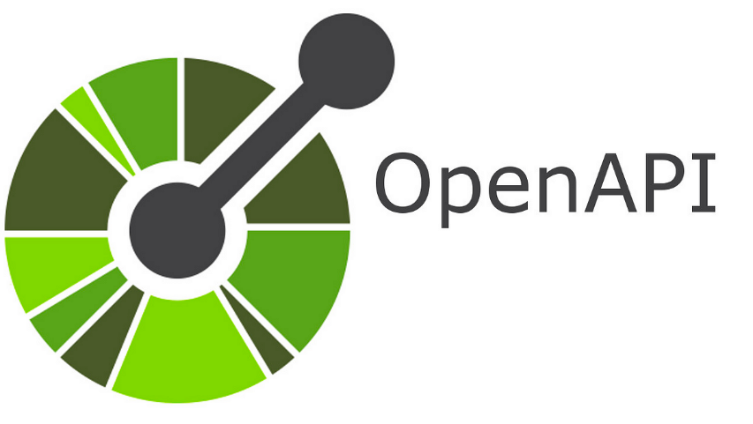
Migrate from Swagger 2.0 to OpenAPI 3.0 specs
Replace `io.swagger:swagger-jersey2-jaxrs` with `io.swagger.core.v3:swagger-jaxrs2-Jakarta` (v2.2.8).
The previous Swagger annotations from package `io.swagger.annotations` had to be replaced with the new OpenAPI annotations from package `io.swagger.v3.oas.annotations`.
This is not a package relocation, but a new set of annotations.
Pro tips: - Define OpenAPI spec and then generate the java classes based on contract.
- Perform OpenAPI spec generation at build time.
45

Slide 46

WireMock dependency classpath clash with Spring boot 3
For Wiremock versions before 3.x
46

Slide 47
Latest WireMock depends on Jetty 11
Spring boot 3 using Jetty 12
47

Slide 48

WireMock dependency classpath clash with Spring boot 3
What NOW?
48

Slide 49
Use the standalone version (fat JAR with shaded dependencies)
<version.wiremock-standalone>3.4.1</version.wiremock-standalone>
<dependency> <groupId>org.wiremock</groupId> <artifactId>wiremock-standalone</artifactId> <version>${version.wiremock-standalone}</version> <scope>test</scope> </dependency>
49

Slide 50

Use Wiremock with Jetty 12
WireMock ships with Jetty 11 by default but fully supports Jetty 12 as well with a new module wiremock-jetty12
50

Slide 51
Graceful shutdown phases
Graceful shutdown begins in phase `SmartLifecycle.DEFAULT_PHASE – 2048`.
The web server is stopped in phase `SmartLifecycle.DEFAULT_PHASE – 1024`
See Updated Phases for Graceful Shutdown in Spring Boot 3.0 migration guide.
51

Slide 52

Integration with Testcontainers
@Container public static final GenericContainer<?> mongo = new GenericContainer<>("mongo:5") .withNetwork(network) .withNetworkAliases(MONGO_SERVICE_NAME) .withExposedPorts(MONGO_SERVICE_PORT) .withCommand("--quiet") // remove for debug logging .withLogConsumer(new Slf4jLogConsumer(LOGGER) .withPrefix(MONGO_SERVICE_NAME) .withSeparateOutputStreams()) .waitingFor(Wait .forListeningPort() .withStartupTimeout(Duration.ofSeconds(10)));
52

Slide 53

Key takeaways
Step upgrades
Use latest versions – third party dependencies
Check for breaking changes
Use OTEL with W3C
Use Micrometer annotations with AspectJ
Use TestContainers
API contract first
53

Slide 54

Questions?
Your experiences?
Laurentiu Marinescu Senior Software engineer
May, 2024

